Slide 1

Temporary Foreign Agricultural Workers Initiative
April 21, 2020

Slide 2
Hosts
Ron Landry
Ministry of Labour
Kim Litchfield
Workplace Safety and Insurance Board
Dean Anderson
Workplace Safety & Prevention Services
Moderator:
Bill Haflidson
Workplace Safety & Prevention Services

Slide 3
Housekeeping Items
Questions? Please ask using the chat function
To be sent to participants later this week:
  PDF of slides with clickable links
  Link to recorded version of webinar

Slide 4
Note
This resource does not replace the Occupational Health and Safety Act (OHSA) and its regulations, and should not be used as or considered legal advice. Health and safety inspectors apply the law based on the facts in the workplace.
It is the responsibility of workplace parties to ensure compliance with the legislation. This document does not constitute legal advice.

Slide 5
Objectives
To provide an overview of the Ministry of Labour, Training and Skills Development (MLTSD)’s Temporary Foreign Agricultural Workers (TFAW) initiative
To outline the risks associated with COVID19 and how to reduce the spread in the workplace
To outline what to expect during an inspection for this initiative
To provide information about resources available to assist workplace parties

Slide 6
Temporary Foreign Agricultural Workers Initiative
When?
Beginning April 21, 2020, MLSTD will conduct proactive workplace inspections focusing on workplaces that employ temporary foreign agricultural workers across Ontario.
Why?
To provide education, support and compliance assistance to employers with regard to the OHSA and restrictions due to COVID19.
Where?
This province-wide initiative will focus on workplaces in the farming and agricultural sectors where temporary foreign agricultural workers are known to work.

Slide 7
The 2019 novel coronavirus (COVID-19)
The 2019 novel coronavirus (COVID-19) causes a respiratory infection that originated in Wuhan, China and has expanded into Canada and many other countries around the world.
The virus typically spreads through close personal contact with an infected person or touching an infected surface, and then touching your mouth, nose or eyes.

Slide 8
Why Focus on TFAWs ?
In response to the current COVID19 global pandemic, MLTSD will be conducting proactive field visits to workplaces that have been deemed to be an essential service and have workers continuing to work. This includes the agricultural sector.
Every year, more than 50,000 temporary foreign workers come to Canada through the Temporary Foreign Workers Agricultural Program to do agricultural work.
The majority of these workers come to Ontario and begin arriving in the spring (March-April).

Slide 9
Workplaces to visit
In an effort to provide education, support and compliance assistance to employers in the agricultural sector, the ministry will be conducting proactive occupational health and safety visits to farms, greenhouses and other locations where agricultural workers, and workers ancillary to agricultural operations such as delivery persons and cleaners are working.
People working as farm and greenhouse workers, equipment operators, maintenance workers, truck drivers, cleaners, delivery persons and administrative staff are just some of those in the agriculture sector who need to consider how they can work safely and prevent the spread of COVID-19.

Slide 10
Compliance
All measures taken to prevent the spread of COVID-19 should be done in compliance with requirements under the Occupational Health and Safety Act, Emergency Orders made under the Emergency Management and Civil Protection Act (EMCPA), and public health directives and guidance issued by Ontario’s Chief Medical Officer of Health and the Ministry of Health.

Slide 11
Inspectors may focus on the following:
How many workers are working
What screening the employer has in place to prevent workers who may have COVID-19 from coming to work
  policies and procedures are in place to ensure that workers with symptoms of COVID-19 are not coming to work.
  *symptoms include: cough, fever, difficulty breathing
How the employer is ensuring physical distancing (a 2m separation) between workers
How the employer is ensuring proper onsite hygiene
Other precautions including the use of personal protective equipment (PPE)

Slide 12
2 metre separation
Where possible, workers are encouraged to keep 2 metres apart.
In circumstances where 2 metres cannot be maintained, the employer must protect the worker from the hazard.
Control measures including robust screening, hand hygiene, cough/sneeze etiquette and frequent cleaning of high touch surfaces are even more important.
In the hierarchy of controls the last line of defence is personal protective equipment (PPE).

Slide 13
Biosecurity
MLTSD understands the important role Biosecurity plays in preventing the transfer of disease and pest infestation between farming operations.
To minimize the possibility of spreading biological hazards when conducting field visits, inspectors are required to follow biosecurity protocol as directed by the ministry’s internal Policy and Procedures Manual.
Inspectors are also asked to observe and respect all biosecurity signage on farms.

Slide 14
Employer responsibilities
Employers have obligations under the Occupational Health and Safety Act (OHSA) and its regulations to protect workers from hazards in the workplace, including infectious diseases.
Under OHSA Employers must:
  Ensure workers know about hazards and dangers by providing information, instruction and supervision on how to work safely
  Ensure supervisors know what is required to protect workers’ health and safety on the job
  Create workplace health and safety policies and procedures
  Ensure everyone follows the law and the workplace health and safety policies and procedures
  Ensure workers wear and use the right protective equipment; and,
  Do everything reasonable in the circumstances to protect workers

Slide 15
Protecting against COVID19
When determining reasonable precautions for the protection of workers during the pandemic, employers should follow the guidance provided by Public Health Ontario and the Ministry of Health. This includes encouraging workers to:
wash hands often with soap and water or alcohol-based hand sanitizer
sneeze and cough into sleeve
if a tissue is used, discard immediately and wash hands afterward
avoid touching eyes, nose or mouth
avoid contact with people who are sick
avoid high-touch areas, where possible, or ensure hands are cleaned afterward
where possible, wear gloves when interacting with high-touch areas. Do not touch face with gloved hands. Take care when removing gloves. Ensure hands are washed after removing gloves
wash clothes as often as possible

Slide 16
What if a worker tests positive for COVID19?
Under the Occupational Health and Safety Act (OHSA), [subsection 52(2)], if an employer is advised that a worker has an occupational illness due to an exposure at the workplace or that a claim has been filed with the Workplace Safety and Insurance Board (WSIB), the employer is required to notify the ministry in writing within four days.
If you have questions or would like to report a critical injury, fatality or report an occupational illness, please call:
Occupational Health and Safety Contact Centre
1-877-202-0008.

Slide 17
OHSA and applicable regulations
During this initiative, MLTSD Inspectors will continue to enforce the OHSA and its regulations, including but not limited to the following:
  Occupational Health and Safety Act, (OHSA)
  Farming Operations Reg. 414/05
  Occupational Health and Safety Awareness and Training, Reg. 297/13
    Training workbooks and accompanying guides for download:
      Worker Health and Safety Awareness in 4 Steps
      Worker Awareness Workbook
      Employer Guide to Worker Health and Safety Awareness in 4 Steps
      Supervisor Health and Safety Awareness in 5 Steps
  Emergency Orders made under the Emergency Management and Civil Protection Act (EMCPA)

Slide 18
Printable posters
Surgical Mask vs. N95 Respirator: https://www.cdc.gov/niosh/npptl/pdfs/UnderstandDifferenceInfographic-508.pdf
How to Self-Isolate: https://www.publichealthontario.ca/-/media/documents/ncov/factsheet-covid-19-how-to-self-isolate.pdf?la=en
How to Self-Monitor: https://www.publichealthontario.ca/-/media/documents/ncov/factsheet-covid-19-self-monitor.pdf?la=en
Cleaning and Disinfection for Public Settings: https://www.publichealthontario.ca/-/media/documents/ncov/factsheet-covid-19-environmental-cleaning.pdf?la=en
Public Health Ontario’s How to Handwash Poster: https://www.publichealthontario.ca/-/media/documents/jcyh-handwash.pdf?la=en
Public Health Ontario Multilingual “How To” Posters: https://www.publichealthontario.ca/en/diseases-and-conditions/infectious-diseases/respiratory-diseases/novel-coronavirus/public-resources?tab=0

Slide 19
Online Resources
Employers and workers can refer to the Ministry’s Guide to the Occupational Health and Safety Act for Farming Operations to understand their health and safety rights and responsibilities. They may also wish to contact one of the health and safety partners for assistance.
Ministry of Health produced the following guidance documents:
Guidance for Temporary Foreign Workers
Guidance for Group Homes and Co-Living Settings
Public Health Unit Locations: http://www.health.gov.on.ca/en/common/system/services/phu/locations.aspx
Please check the Ministry of Health (MOH) COVID-19 website regularly for updates, FAQs, and other information related to COVID19.

Slide 20

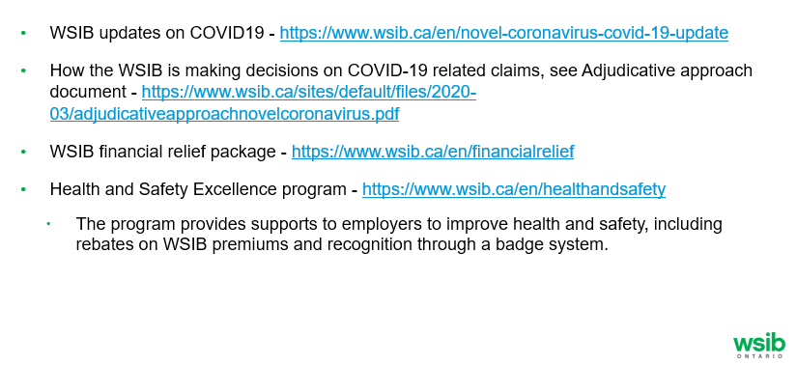
WSIB COVID-19 supports for employers

Slide 21
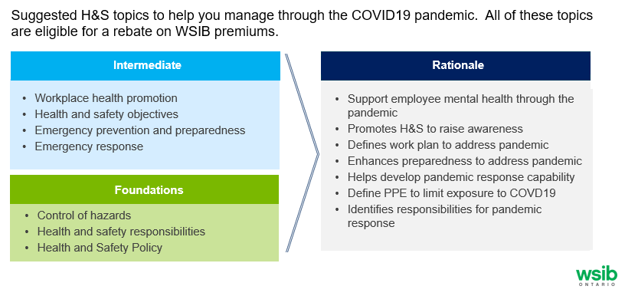
Health and Safety Excellence program topics relevant to COVID-19

Slide 22
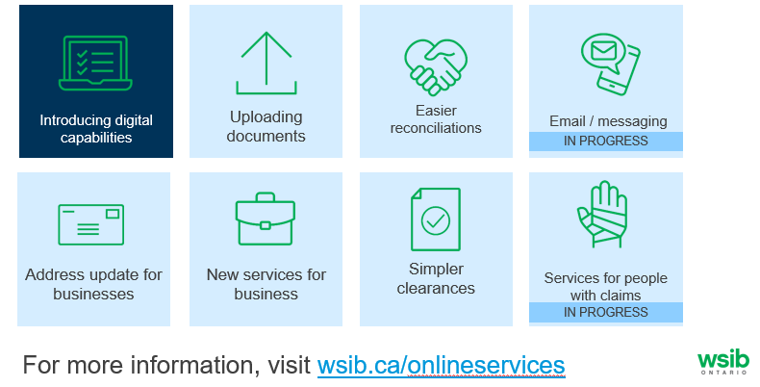
Making it easier to work with us

Slide 23
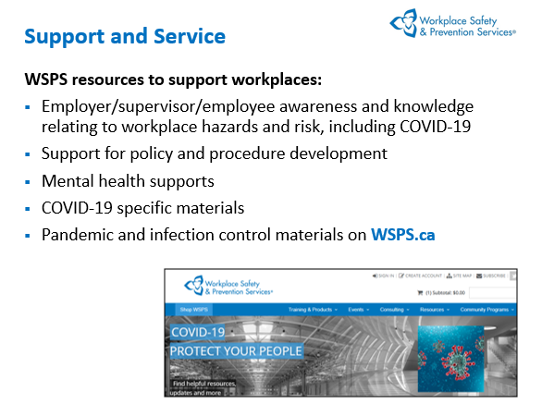

Slide 24
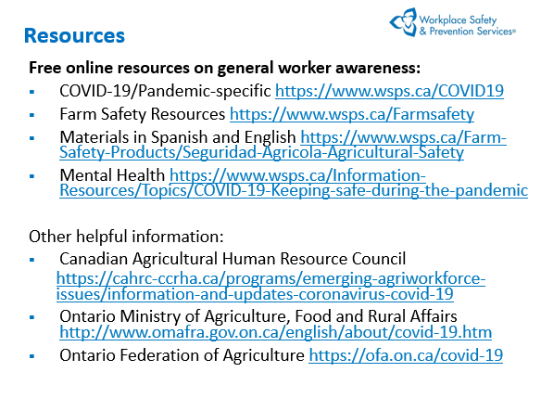

Slide 25


Slide 26
Questions?
For Internal Use Only

Slide 27
Thank You!
For Internal Use Only

